Slide 1

DealNest – A Hyperlocal QR-Based Coupon Marketplace for College Ecosystems
2410030245-vishnuchethana
2410030248-swathi
2410030249-Nikhila
2410030348-bhavana
Under the guidance of
(Chiranjeevi sir & Madhukar Sir)

Slide 2
Introduction
Digital coupon platforms and hyperlocal deal marketplaces have evolved significantly over the past decade. Several companies and research models provide insight into the feasibility, challenges, and sustainability of such systems.

Slide 3
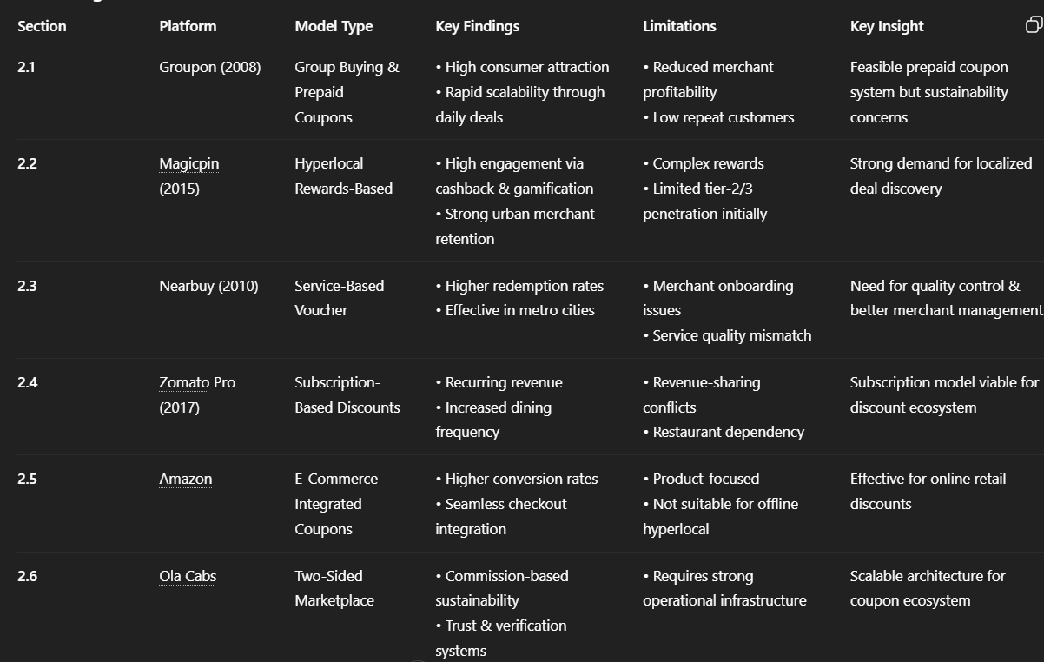
Existing Platforms and Models

Slide 4
RESEARCH GAP
No college-focused hyperlocal coupon ecosystem
Limited secure QR-based one-time redemption
Lack of merchant analytics for small businesses
No simple commission model for micro-enterprises
Platforms focus on large cities or product-based e-commerce
No tightly controlled campus-centric ecosystem

Slide 5
PROPOSED SOLUTION
College-focused hyperlocal coupon marketplace
Secure QR-based one-time redemption
Verified merchant partnerships
Transparent commission-based model
Analytics dashboard for local businesses

Slide 6
IEEE-Style References
[1] Groupon, Online group buying platform, 2008.
[2] Magicpin, Hyperlocal rewards and deals platform, 2015.
[3] Nearbuy, Local services discount marketplace, 2010.
[4] Zomato Pro, Membership-based dining discount system, 2017.
[5] Amazon, Integrated digital coupon system, 2011.
[6] Ola Cabs, Two-sided commission-based marketplace model, 2010.

